Slide 1


Report Designer #1
ERP Software Designed for Local Government
bsasoftware.com

Slide 2


ANDREW KLEIN
PROJECT MANGEMENT
Andrew Klein works in our Project Management Team specializing in the Financial Management and Utility Billing Suites at BS&A Software. Andrew has over 8 years of experience working with local governments of all sizes assisting them with software implementation, data conversion, change management, process review and reengineering, and has assisted many governments across the country. In his free time he enjoys watching sports, playing golf, and spending time with friends and family​
AKlein@bsasoftware.com

Slide 3
Agenda
Adding/Editing Reports
Layout of Report Designer
Field List, Toolbox, Property Grid
Fields
Formatting Tools

Slide 4
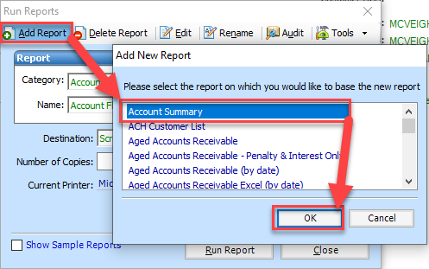
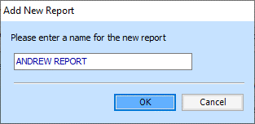

Adding A New Report
Add Report
Select Report to Base Off Of
Provide Title

Slide 5

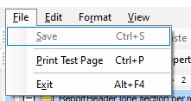
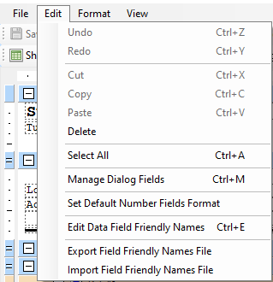
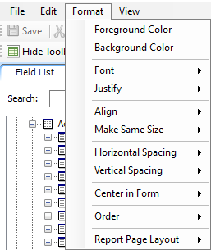
Layout of Report Designer – Menu Bar
File
Edit
Format
View
Notes:
The Menu Bar contains many of the same options as the tool bar described below, though some are unique. Some often used menu items are: Save, Print Test Page, Undo, Redo, and various field alignment options.

Slide 6
Layout of Report Designer – Tool Bar
Font Type
Font Size
Alignment
Copy, Cut, Paste, Save
Notes:
The Tool Bar provides convenient, one-click access to certain items contained in the Menu Bar. Especially useful are the font type, size, style, and alignment buttons and list boxes.

Slide 7
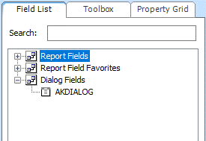
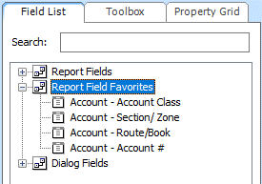
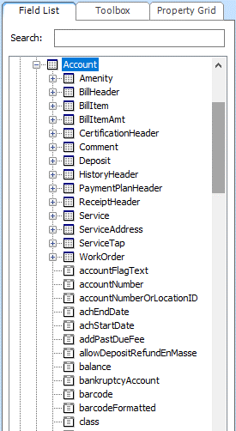
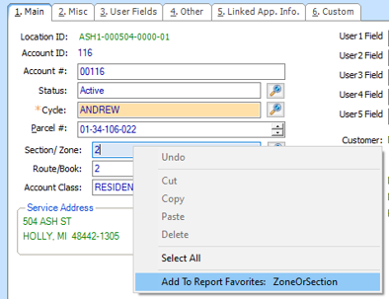
Field List
Report Fields
Favorite Fields
Dialog Fields

Slide 8
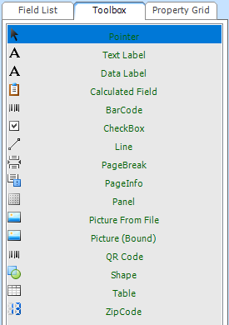
Toolbox
Pointer
Text Label
Data Label
Calculated Field
Barcode
Checkbox
PageBreak
PageInfo
Picture From File
QR Code
Shape
Table
ZipCode
Notes:
Pointer - This is the same as having nothing selected.
Text Label - Allows a label to be added to the report that consists of text.
Data Label - A data field pulled from the program (similar to the Field List tab).
Calculated Field - A field that can be set up to perform a custom calculation.
BarCode - A barcode that can be scanned to speed up entry.
CheckBox - A field that can be checked or unchecked by pen when the report is printed.
Line - Allows a line to be added to the report. This is useful for separating sections.
PageBreak - Splits a report up over multiple pages at the point of the page break.
PageInfo - Displays the report page number, current date, count information, and more.
Panel - Tools placed within a panel will move together when the panel is moved.
Picture From File - Displays a picture that the user specifies.
Picture (Bound) - Useful in Assessing, only. Used to display images bound to fields.
QR Code - Generates a QR code bound to a field. This, like a barcode, can be scanned.
Shape - Adds a shape from a list of predefined shapes.
Table - A grid that can help in keeping fields and tools uniform on a report.
ZipCode - Displays a zip code with special font.

Slide 9
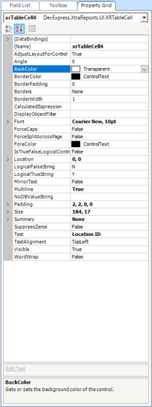
Property Grid
Settings For Fields/Reports
Explanation
Notes:
The Property Grid tab allows the manipulation of many settings in the report. The Property grid tab shows the properties for whichever field/section/tool is selected.
The Property Grid can be set up with different views by clicking these buttons near the top:
This displays categories that contain each field. For example, the field BackColor is contained in the Appearance category as shown to the left. Categories can be expanded and contracted by clicking on the small triangle to the left of them.
This is the default view.
This displays all fields, regardless of category, in alphabetical order.
The box at the bottom displays a description of the selected property. This is very useful, especially for those who are just getting familiar with the Report Designer.

Slide 10
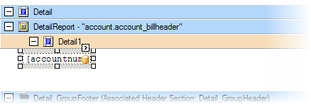
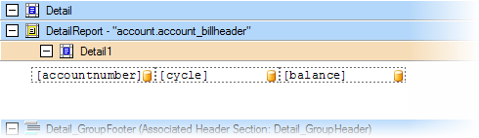
Fields
Resizing & Moving Fields (Stand-Alone)
Resizing & Moving Fields (Table)
Notes:
Resizing Stand-Alone - Clicking on a stand-alone field will reveal a border with handles for stretching. These can be clicked and dragged to resize the field. Fields can also be resized after they are selected by changing the Size property in the Property Grid. Format > Make Same Size
Moving Fields Stand-Alone - Fields can be moved by clicking and dragging them with the mouse, clicking and using the arrow keys, and by changing the Location property in the Property Grid. The last two options are good for fine-tuning placement. Format > Align Lefts, Centers, Rights
When a field is added to a table, it can be resized and moved less freely than a stand-alone field since they are dependent on the size and position of the other cells in the table. The positive of working with fields in a table is that fields are lined up fairly easily.
Resizing Fields Table - An individual field can be clicked on in a table to reveal handles, just as with a stand-alone field, but the field can only be stretched horizontally since the overall height of the row is determined by the table instead of the field.
The Esc key can be used to ‘back up a level’ when a field in a table is selected. This allows for manipulation of the row and overall table dimensions.
Moving Fields Table - Fields cannot be moved within a table. They can only be resized; however, the entire table can be moved by clicking the field then hitting Esc twice in order to select the entire table then clicking and dragging or using the arrow keys on the keyboard.

Slide 11
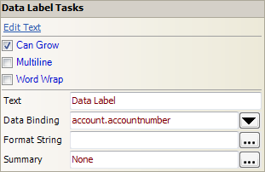
Fields – Data Label Tasks
Edit Text
Can Grow
Multiline
Word Wrap
Notes:
Edit Text - Allows the manipulation of the text displayed by the data label. If the data label is bound to a field in the program then the bound info overrides the text.
Can Grow - Allows the field to grow if the bound data will be larger than the size of the field.
Multiline ‐ Multiline should be checked if a text field is added to a report that needs to spread over multiple lines.
Word Wrap - Automatically moves text that extends beyond the left or right edges of the field to the next line

Slide 12
Fields – Data Label Tasks
Text
Data Binding
Format String
Summary
Notes:
Text - Another way to manipulate the text displayed.
Data Binding - Allows the bound data field that the data label displays to be changed. This also allows one data label to display multiple different bound fields. For example, if
Format String - Allows the format of the data displayed to be changed. Common formats include date, decimal, or currency.
Summary - Allows the data displayed by the field to be summarized. An example of this would be a the total number of records shown on the report, or a total dollar amount for all account balances shown on a report.

Slide 13
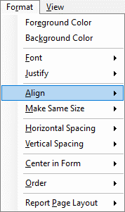
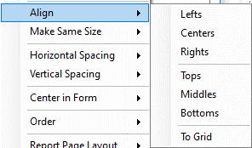
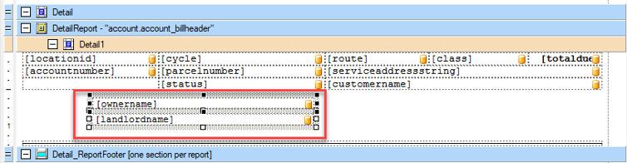
Formatting Tools - Align
Select Multiple Fields
Anchor Field
Necessary Alignment
Notes:
Align - This is used to bring multiple fields into alignment at once instead of clicking each field and moving them into alignment individually. Steps to align multiple fields are below:
Shift-click or box-select the fields that should be aligned.
Box-selecting is done by left-clicking in an open space on the report, holding the button down, and dragging the mouse in any direction. Anything that is inside or touching the edges of the dashed box that appears will be selected.
Removing fields from a selection can be done by Control-clicking any field that should not be selected.
2. Once all fields are selected that should be aligned, the field that the other fields should be aligned to (or the “anchor field”) will need to be selected. Do this by clicking the field.
The anchor field is designated by black boxes around it, as shown below. Non-anchor fields will have white boxes around them.
3. With the anchor-field selected, the alignment can be done. Click Format > Align, and choose the alignment type.
The fields should snap into alignment.

Slide 14
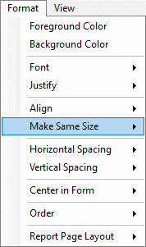

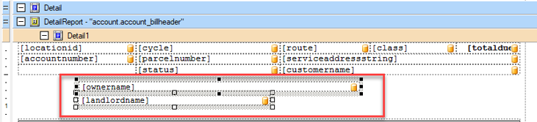
Formatting Tools – Make Same Size
Select Multiple Fields
Anchor Field
Necessary Alignment
Notes:
Make Same Size - This is used to make multiple fields the same size as one another. Steps to make fields the same size are shown below:
Select the fields to make the same size by clicking one then shift-clicking the others or by using the box-select method described above.
Choose the anchor field from the selected fields by clicking on it.
Click Format > Make Same Size and choose which dimensions should be conformed to the anchor field.
All selected fields should match the dimensions of the anchor field.

Slide 15
Questions
ANDREW KLEIN
PROJECT MANGEMENT
Andrew Klein works in our Project Management Team specializing in the Financial Management and Utility Billing Suites at BS&A Software. Andrew has over 8 years of experience working with local governments of all sizes assisting them with software implementation, data conversion, change management, process review and reengineering, and has assisted many governments across the country. In his free time he enjoys watching sports, playing golf, and spending time with friends and family​
AKlein@bsasoftware.com

Slide 16

THANK YOU

