Slide 1


Report Designer #2
ERP Software Designed for Local Government
bsasoftware.com

Slide 2


ANDREW KLEIN
PROJECT MANGEMENT
Andrew Klein works in our Project Management Team specializing in the Financial Management and Utility Billing Suites at BS&A Software. Andrew has over 8 years of experience working with local governments of all sizes assisting them with software implementation, data conversion, change management, process review and reengineering, and has assisted many governments across the country. In his free time he enjoys watching sports, playing golf, and spending time with friends and family​
AKlein@bsasoftware.com

Slide 3
Agenda
Dialog Fields
Bands/Sections
Sorting & Subtotals
Calculated Expressions

Slide 4
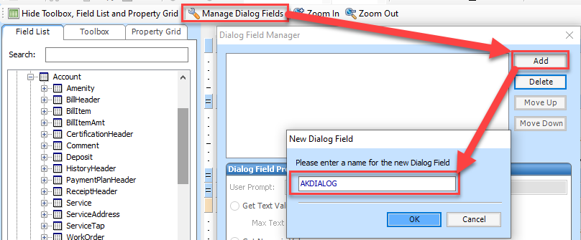

Dialog Fields
Prompts User For Input
Can be Used With Advanced Queries
Add Field
Provide Name
Notes:
A Dialog Field is a field that can be added to a report which prompts the user for input when the report is run. When the report displays it will show information based on the input.

Slide 5
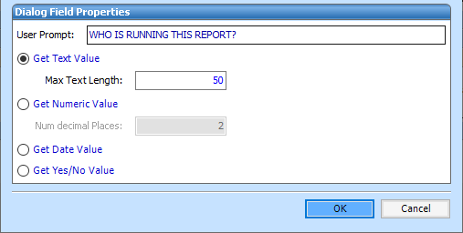
Dialog Fields
User Prompt
Get Text Value
Get Numeric Value
Get Date Value
Get Yes/No Value
Notes:
The User Prompt is the text that the user will see when the report is run. For example: ‘Please enter your name.’ would prompt the user to enter their name.

Slide 6
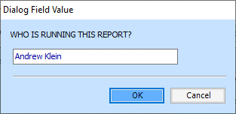
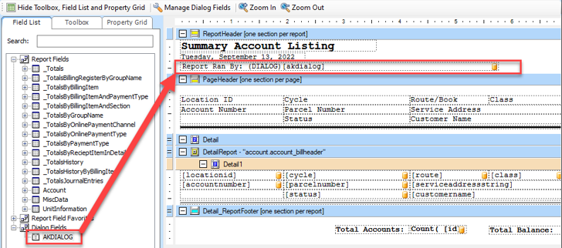
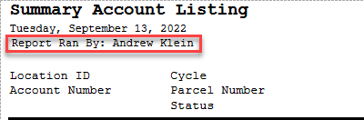
Dialog Fields
Add Field To Report
Prompt Appears Once Report Is Generated
Notes:
The created dialog box is then added to the Field List tab on the left side of the Report Designer window under Dialog Fields.
This can be dragged onto the report and placed wherever the information should be displayed.
Note: The prompt shown will present itself whether the dialog field is placed on the report or not. Deleting the dialog field via the Dialog Field Manager Window will remove the prompt.

Slide 7
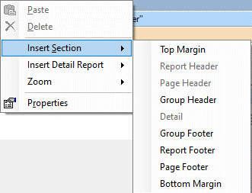
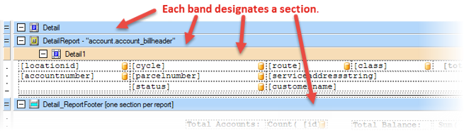
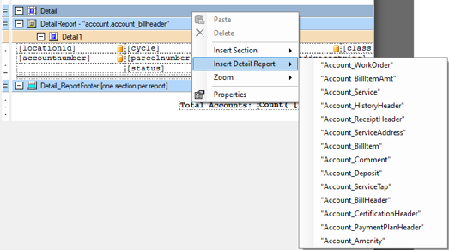
Bands/Sections
Primary Detail Band
Secondary DetailReport Band
Added by Right-Click
Notes:
Each section can contain fields and tools according to need.
A section band shows the name of the band (ex: DetailReport) and can also show the corresponding table that the fields should come from in order to be displayed properly (ex: account.account_billheader).

Slide 8
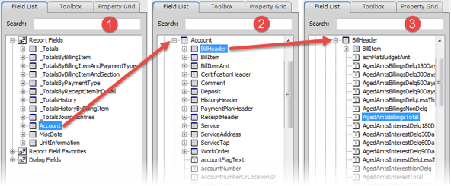
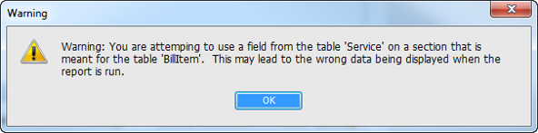
Bands/Section
Fields for Secondary Detail Band
Warning Message
Notes:
The table information reveals that the fields that would work best in the DetailReport section shown would be located within the BillHeader table inside of the Account table. The screenshot below shows how to access the fields contained within the BillHeader table so they can be added to the report
While the Report Designer will allow any field to be added to any section, a warning message will be displayed if a data field is potentially incompatible with the section:

Slide 9

Bands/Sections – Band Types
Top Margin
Report Header
Page Header
Group Header
Detail
Detail Report
Group Footer
Report Footer
Page Footer
Bottom Margin
Notes:
Top Margin - Fields placed here appear in the top margin of every page generated.
Report Header - Fields placed here appear at the beginning of the report.
Page Header - Fields placed here appear at the top of every page generated.
Group Header - Allows for grouping, sorting, and totaling information in different ways. Fields placed here appear once at the top of the group.
An example of a way this section could be used would be grouping accounts together according to cycle, sorting the cycle alphabetically, and adding a total account balance per cycle.
Detail - The Detail band appears once for every record found. In the case of an Account Summary report, the Detail band would appear once for every account.
The Detail band is where DetailReport bands can be placed.
Detail Report - The DetailReport band has two parts. The DetailReport band is inseparable from the tan-colored, indented Detail band below it.
The DetailReport band shows the name of the table from which the fields can be drawn in quotes.
Group Footer - The GroupFooter section prints at the bottom of a detail section. If Detail sections are grouped via a GroupHeader in any certain way, the GroupFooter band will appear at the end of each detail group as specified. The GroupFooter band shows the name of the GroupHeader band that it is associated with in parenthesis. This is a good way to display totals for a groups of records, such as total number of accounts per cycle.
Report Footer - Fields placed in the ReportFooter section will display at the end of the report.
Page Footer - Fields placed in the PageFooter section will display at the bottom of every page.
Bottom Margin - Fields placed in the BottomMargin section will display in the bottom margin of every page.

Slide 10
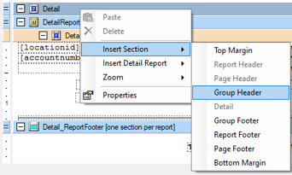
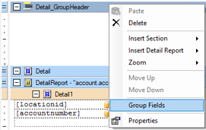
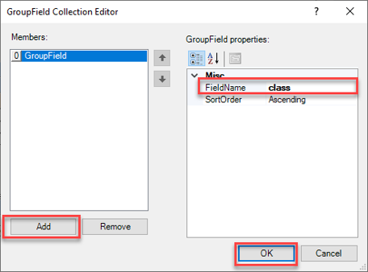
Sorting
Group Header
Group Fields
Add > Field Name
Sort Order
Notes:
A report can be sorted according to a certain field by first adding a Group Header then manipulating the GroupField settings associated with the header.
The following steps show how this can be done in a copy of the Account Summary report.
Right-click the Details band and select Insert Section > Group Header.
This will add a GroupHeader section to the report.
2. Right-click the newly-added GroupHeader band and select Group Fields.
This will show the GroupField Collection Editor window.
3. Click Add.
4. Select the FieldName that the report should sort by. For example: class (shown in the above screenshot).
5. The SortOrder can be changed based on if the report should show the classes in Ascending (alpha-numeric) order, or Descending (reverse alpha-numeric) order.
6. Click OK.
7. When the report is run it will sort all accounts according to class from A-Z.

Slide 11
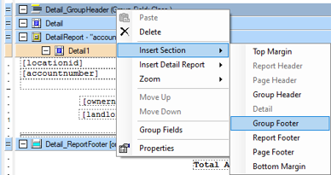
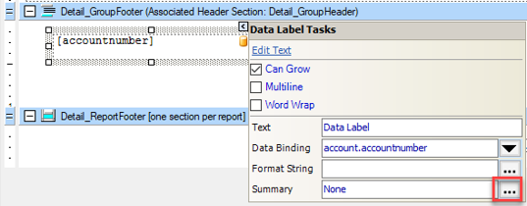
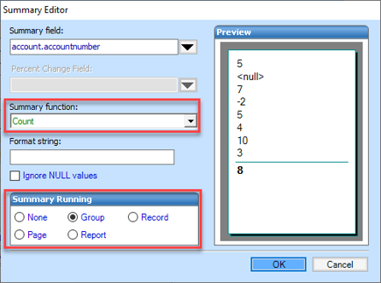
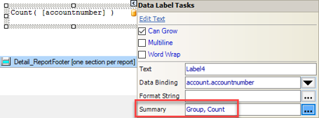
Subtotals
Group Footer
Add Field
Summary
Function
Summary Running
Notes:
In the above example, account records in the Account Summary report have been grouped according to class and sorted. We can then subtotal information per class group and show it after the last account in each group using a Group Footer.
The example below continues from the steps above and shows how to display, in a field, the total number of accounts in the class after the last record in the class.
Open the Account Summary report that was sorted by class in the previous section.
Right-click the GroupHeader band and select Insert Section > Group Footer.
The GroupFooter band will appear with the GroupHeader that is associated with it named in parenthesis.
3. Find the accountNumber field in the Field List and drag it into the new Group Footer section.
4. Select the accountNumber field in the report, if it’s not already selected, and click the button in the upper-right.
5. Click the three dots button next to the Summary field.
This will show the Summary Editor window.
6. Select Count in the Summary function dropdown (shown in the above screenshot).
7. Select Group in the Summary Running section (shown in the above screenshot).
8. Click OK.
9. When the report is run it will show a total number of accounts in each class after the last record in the class.
This is just one way information can be summarized in a report. The Summary function dropdown contains many other ways to summarize information including Average, Sum, Min Value, and Max Value to name a few.

Slide 12
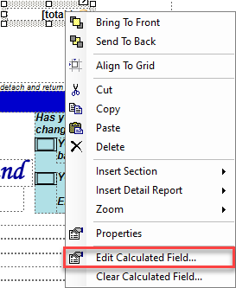
Calculated Expressions –
If Statements
Example : Credit Balance Message On Bill
Add Total Due Field
Edit Calculated Field
Notes:
Goal of the Expression is to display **CREDIT BALANCE DO NOT PAY** if the Account Has a Credit on their Account.

Slide 13
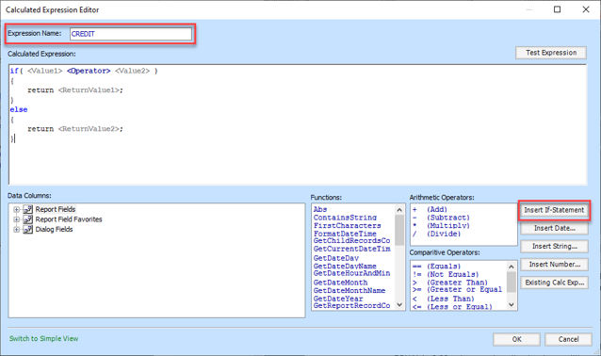
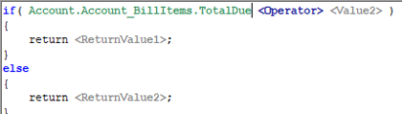
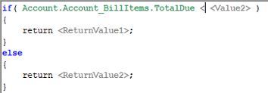
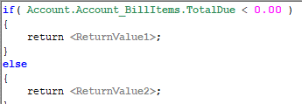
Calculated Expressions –
If Statements
Name Expression
Insert If-Statement
Value 1
Operator
Value 2
Notes:
Goal of the Expression is to display **CREDIT BALANCE DO NOT PAY** if the Account Has a Credit on their Account.
Value 1 – Represents the Data Field that you will be referencing for your Expression
Operator – Can use Arithmetic or Comparative Operators
Value 2 – Criteria for expression to be searching for

Slide 14
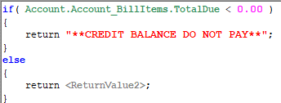
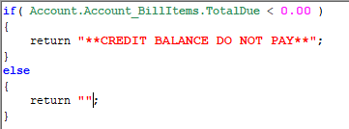
Calculated Expressions –
If Statements
Return Value 1
Return Value 2
Notes:
Goal of the Expression is to display **CREDIT BALANCE DO NOT PAY** if the Account Has a Credit on their Account.
Return Value 1 – How you want your field to show if the condition is TRUE
Return Value 2 – How you want your field to show if the condition is FALSE

Slide 15
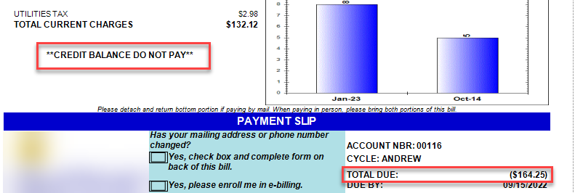
Calculated Expressions –
If Statements
Notes:
Goal of the Expression is to display **CREDIT BALANCE DO NOT PAY** if the Account Has a Credit on their Account.

Slide 16
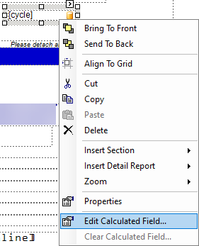
Calculated Expressions - Expressions
Used for Adding Multiple Fields Together
Example : Adding Cycle / Route To Bill
Add Cycle
Edit Calculated Field
Notes:
Goal of the Expression is to display Cycle & Route together on the Bill

Slide 17
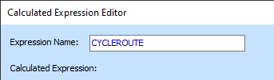


Calculated Expressions –
Expressions
Name Expression
Type return (
Find Field 1
Operator
Space
) ; to finalize
Notes:
Goal of the Expression is to display Cycle & Route together on the Bill

Slide 18
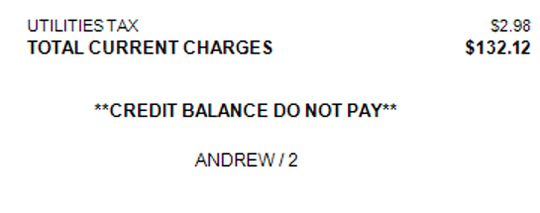
Calculated Expressions –
Expressions
Notes:
Goal of the Expression is to display Cycle & Route together on the Bill

Slide 19
Questions
ANDREW KLEIN
PROJECT MANGEMENT
Andrew Klein works in our Project Management Team specializing in the Financial Management and Utility Billing Suites at BS&A Software. Andrew has over 8 years of experience working with local governments of all sizes assisting them with software implementation, data conversion, change management, process review and reengineering, and has assisted many governments across the country. In his free time he enjoys watching sports, playing golf, and spending time with friends and family​
AKlein@bsasoftware.com

Slide 20

THANK YOU

