Slide 1
Payment Plans

Slide 2
Enabling Payment Plans
Program Setup > Database Setup > Payment Plans > Enable Payment Plan Processing

Slide 3
Payment Spread
How payments need to be allocated
Current then Past Due Balances
Setup unique to default Payment Spread

Slide 4
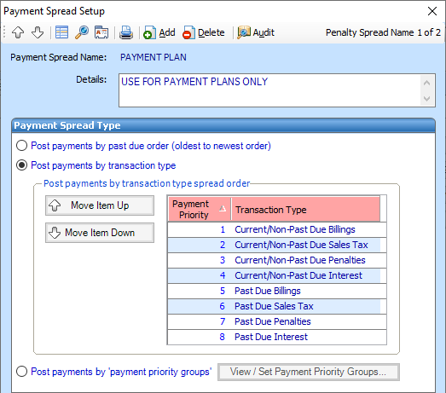
Payment Spread Setup
Program Setup > Database Setup > Payment Spread Setup
Spread titled Payment Plan
Current Charges to be paid first

Slide 5
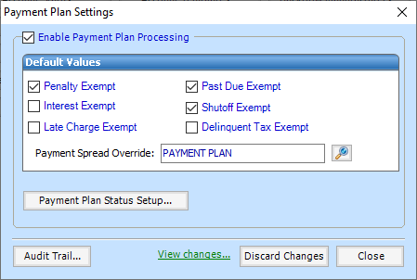
Payment Plan Defaults
Program Setup > Database Setup > Payment Plan Setup
Set Payment Spread Override
Default Values
Statuses

Slide 6
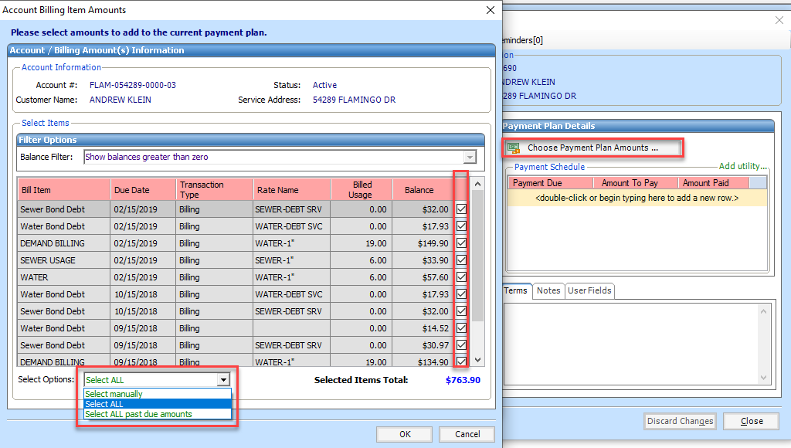
Applying to Accounts
Add Payment Plan
Choose Payment Plan Amounts
Amounts Manually, Past Due Amounts, or All Amounts

Slide 7
Applying to Accounts
Spread Payments
Done Manually or with Utility
Utility will spread payment consistently either weekly, biweekly, or monthly

Slide 8
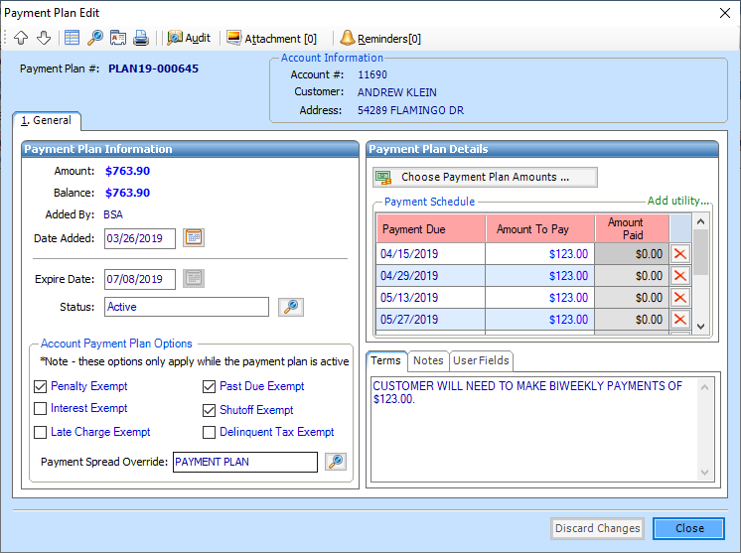
Applying to Accounts

Slide 9
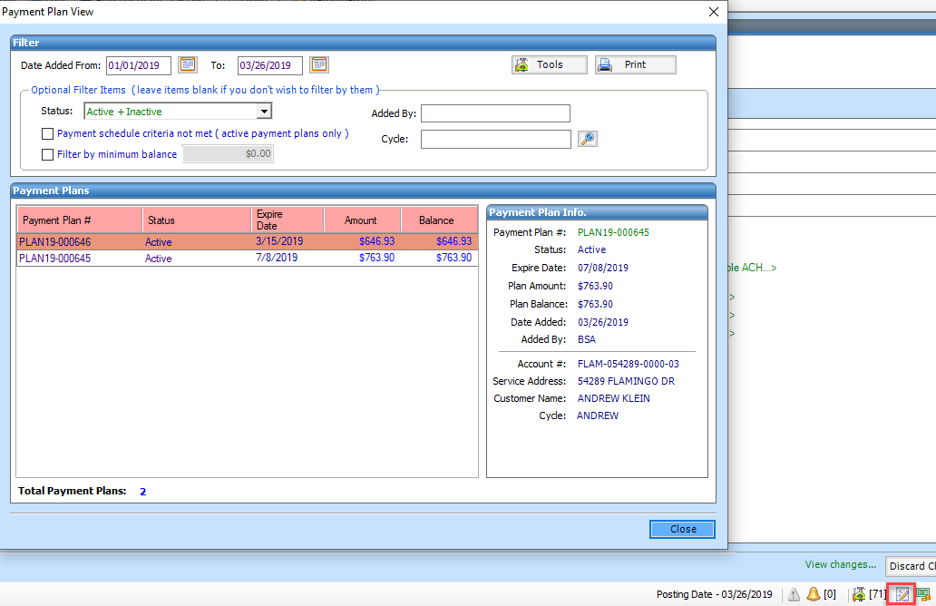
Maintaining Payment Plans
Optional Filters
Adding Work Orders
Mass Inactivate

