Slide 1
Read Verification Utility

Slide 2
What is the Read Verification Utility?
Find Fault Meters
Meters Not Read
Estimated X Number of Times
Zero Consumption Meters

Slide 3
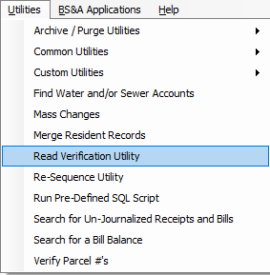
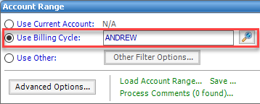
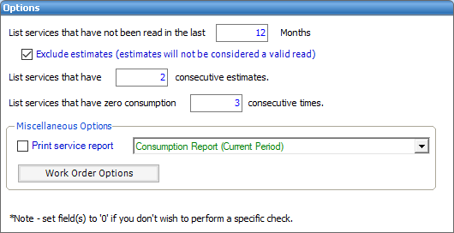
Using the Read Verification Utility
Utilities > Read Verification Utility
Account Range
Options
Reporting
Work Orders

Slide 4
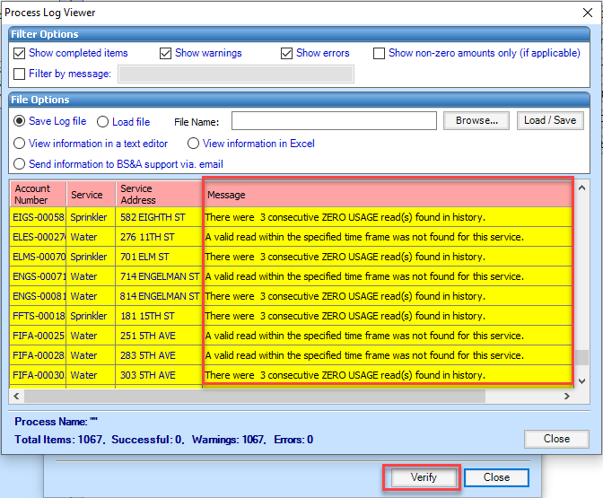
Read Verification
Verify
Looks at All Metered Services
Process Log Viewer

Slide 5
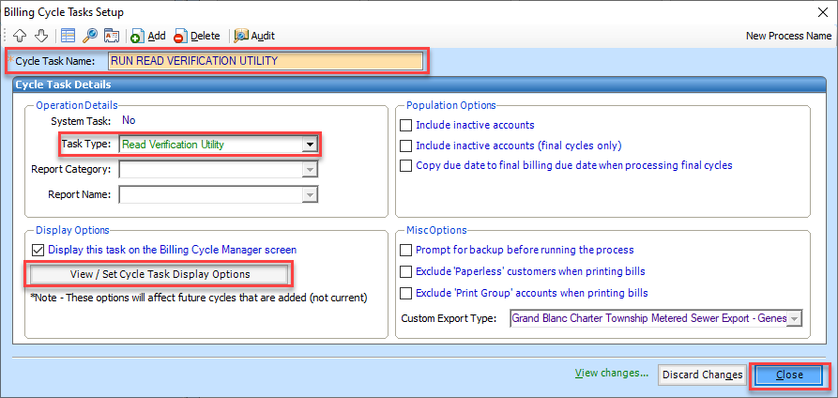
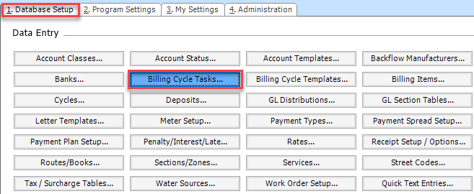
Read Verification
Can Be Added as a Billing Task
Program Setup > Database Setup > Billing Cycle Tasks
Create Task
Task Type
Set Display Order

